Slide 5
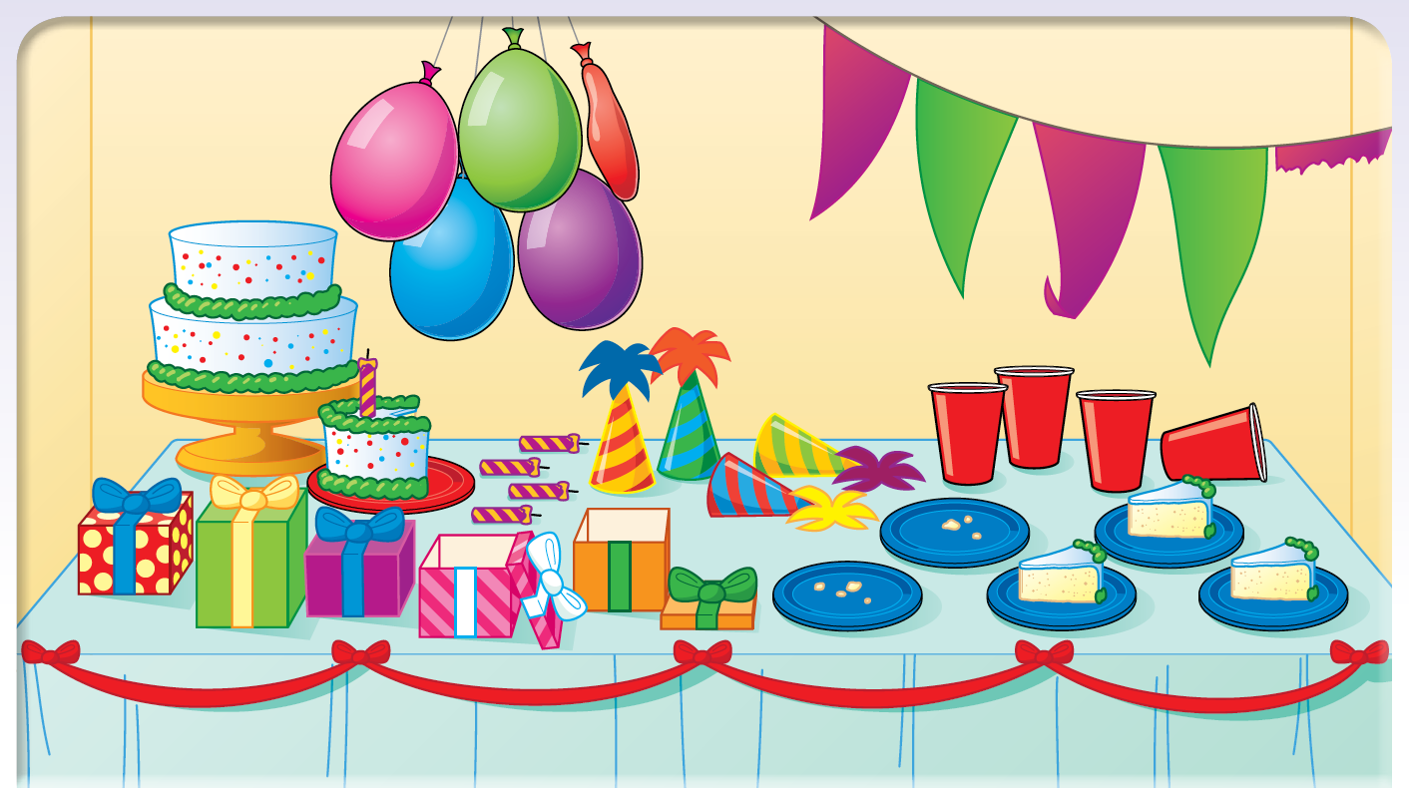

Slide 9
If somebody eats another slice of cake, how many will be left?

Slide 10
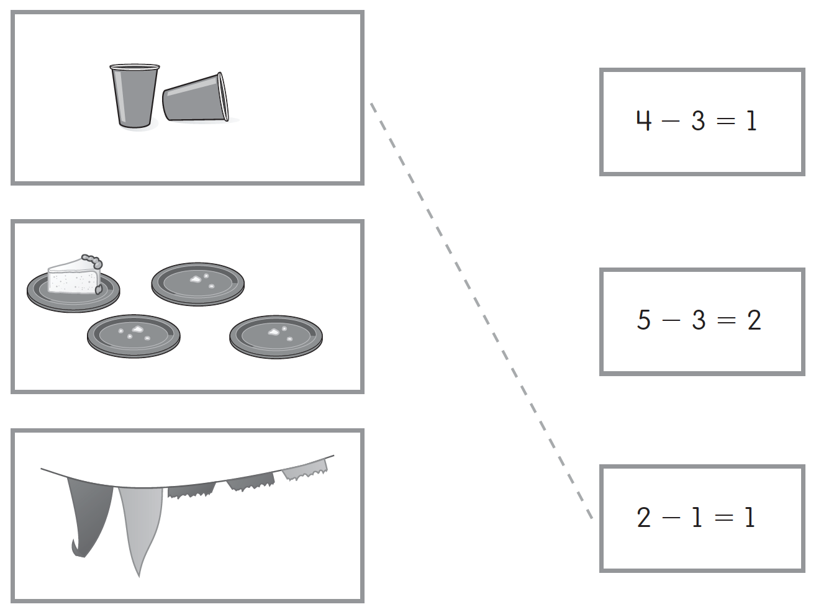

Slide 12
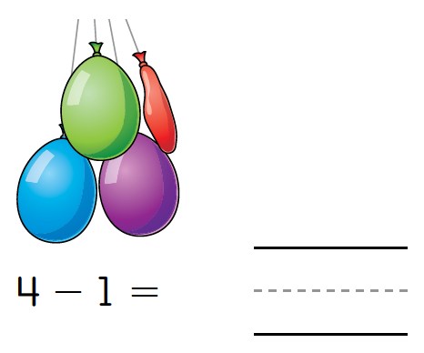

Slide 16
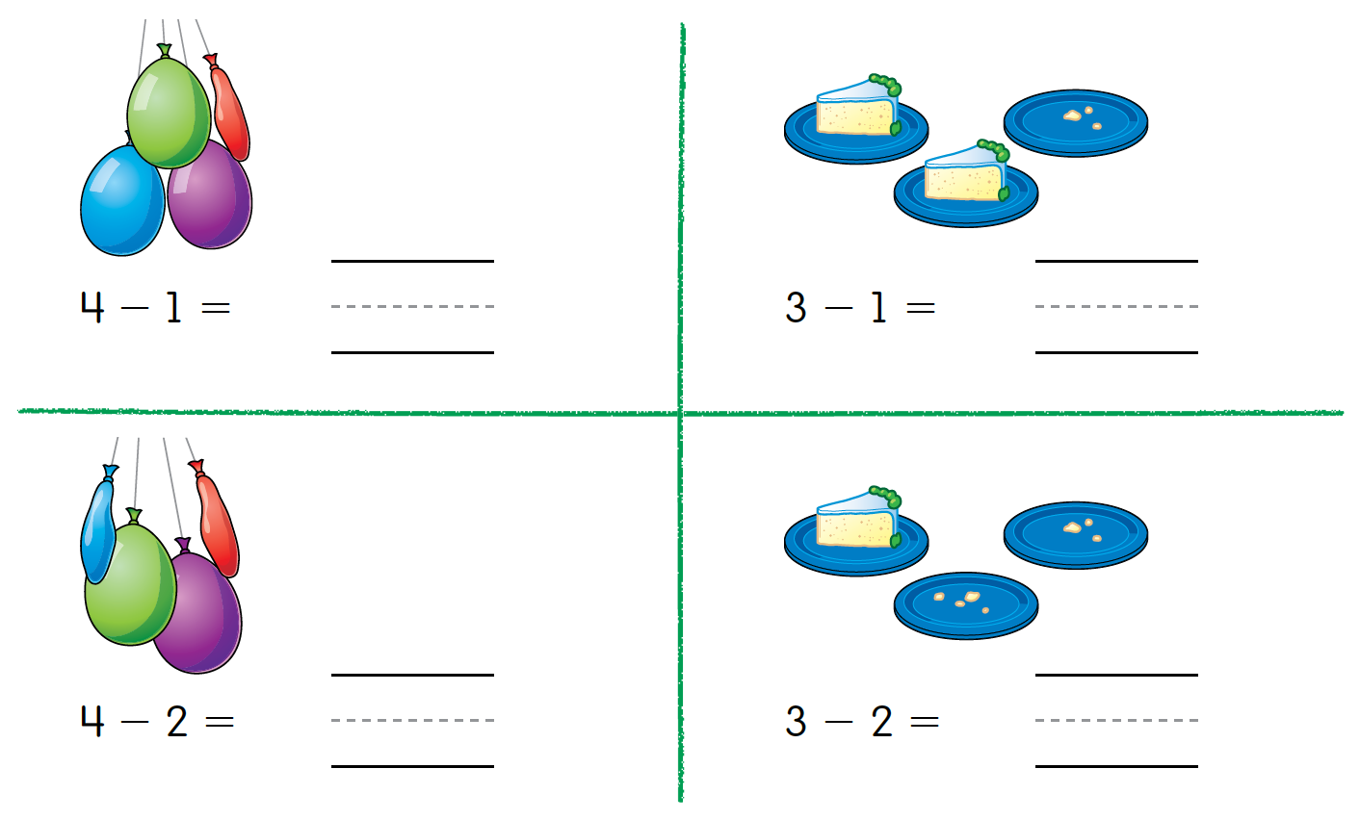

Slide 17
Can you tell a subtraction story about the cake plates?

Slide 18
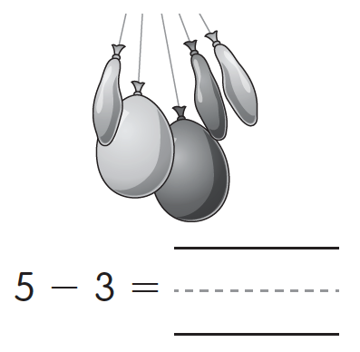

Slide 24
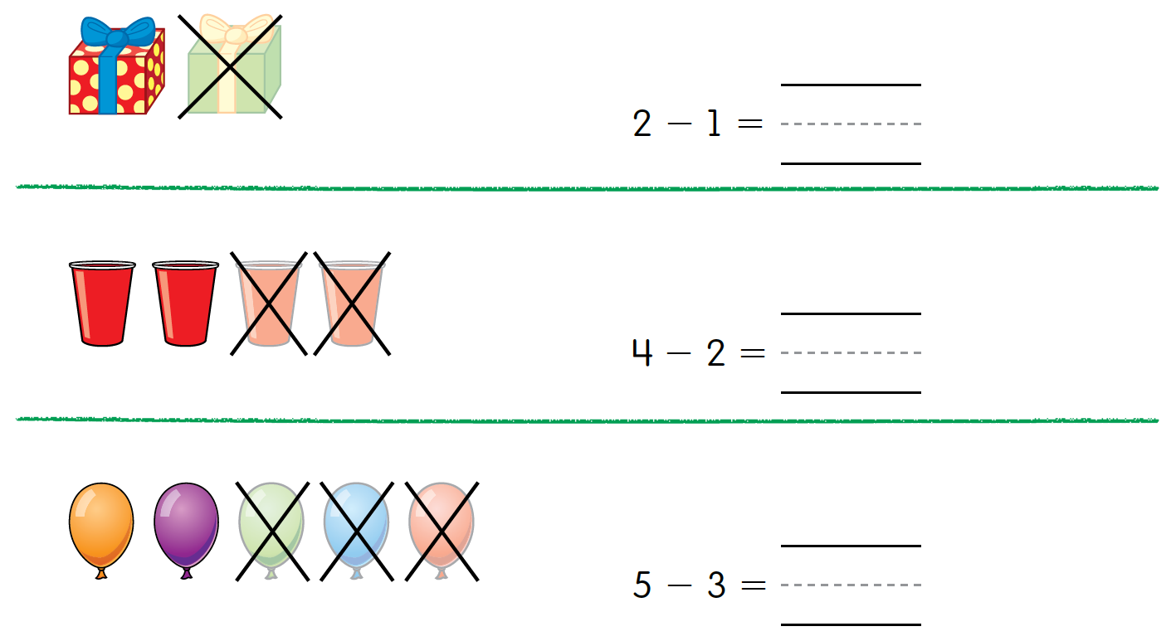

Slide 25
Work with a partner. Tell two different stories about the balloon problem.

Slide 32
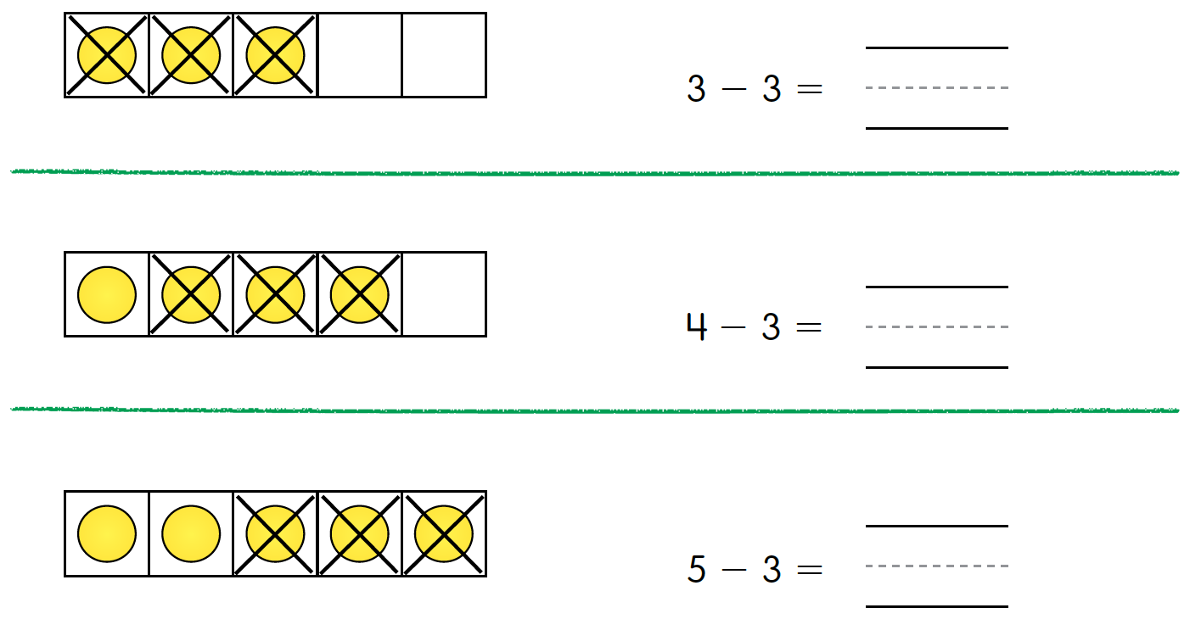

Slide 33
What pattern do you see when you look at your answers?
What pattern do you see when you look at the pictures?

